Slide 1

Laboratory diagnosis of parasitic infections
Mosab NourAldein

Slide 2
Samples and transmission mode
Mostly there are an intimate relationship between mode of transmission of parasite and parasitological specimens
E.g.: fecal oral route (FOR): stool
Blood transfusion : blood
Congenital transmission :amniotic fluid

Slide 3
General consideration
time of collection
Type of specimen
site of collection
Specimen container
Specimen preservation
Safety

Slide 4
Parasitological specimens
Blood
Urine
Stool
Biopsy /aspirate
CSF
Sputum

Slide 5
Methods of diagnosis
Microscopy
Serology
Cultivation
Molecular techniques

Slide 6
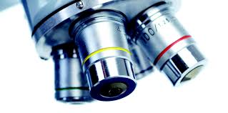
Microscopy

Slide 7
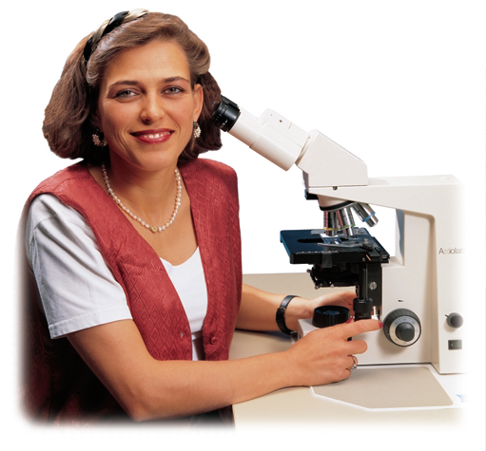
Cont
For many years, microscopy has been the only tool available for the detection of parasites through inspection of blood smears ,tissue specimens ,feces, lymph node aspirates ,bone marrow and even cerebrospinal fluid [

Slide 8
Direct examination
However, sample preparation for direct observation is time-consuming, labor intensive, and proper diagnosis depends on qualified laboratory technicians.
In reality, all major intestinal helminthes infections are still solely dependent on microscopy for diagnosis. .

Slide 9
cont
As for other parasite infections, many are confirmed by the use of microscopy in conjunction to other methods of diagnosis including serology-based assays and more recently molecular-based assays.

Slide 10
Concentration techniques
The main purposes of concentration techniques are to:
1-increase the parasite number
2-to remove debris
3- count parasite
4-montoring the treatment

Slide 11
Cont
Stool concentration techniques
Either by :
Sedimentation
Flotation

Slide 12
Cont
Sedimentation methods :
Formal ether centrifugation concentration technique
Formal detergent concentration technique
Flotation technique :
Saturated sodium chloride flotation technique .
Zinc sulphate flotation technique

Slide 13
Blood concentration techniques
Buffy coat technique
venous blood concentration technique venous blood filtration concentration
Technique.
Buffy coat technique
Knott concentration technique triple centrifugation tube concentration technique

Slide 14
Staining techniques
Temporary staining techniques permanent staining techniques

Slide 15
Serology
In absence of tissue or biologic parasitic specimen or when lacking the microscopy .
Either it detects parasitic antigen or it detect antibodies produced as a result of parasitic infection .

Slide 16
Cont
in case of antibody detection it does not discriminate between active and past infection .

Slide 17
ELISA
Enzyme-linked Immunosorbent Assays (ELISAs) combine the specificity of antibodies with the sensitivity of simple enzyme assays, by using antibodies or antigens coupled to an easily-assayed enzyme.

Slide 18
Cont
ELISAs can provide a useful measurement of antigen or antibody concentration .
There are two main variations on this method: The ELISA can be used to detect the presence of antigens that are recognized by an antibody or it can be used to test for antibodies that recognize an antigen.

Slide 19
Procedure
1) coat the microtiter plate wells with antigen; 2) block all unbound sites to prevent false positive results;
3) add primary antibody (e.g. to the wells;
4) add secondary antibody conjugated to an enzyme
5) reaction of a substrate with the enzyme to produce a colored product, thus indicating a positive reaction.

Slide 20
RDTS
rapid diagnostic tests (RDTs) have the potential to greatly improve the quality of management of infections, especially in remote areas with limited access to good quality microscopy services

Slide 21
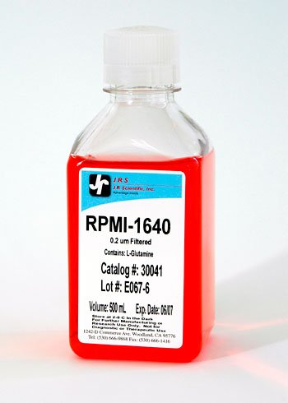
Cultivation
Invitro cultivation :
using culture media i.e. RPMI1640.

Slide 22
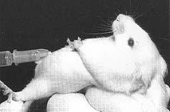
CONT
Ivivo cultivation :
Animal inoculation

Slide 23
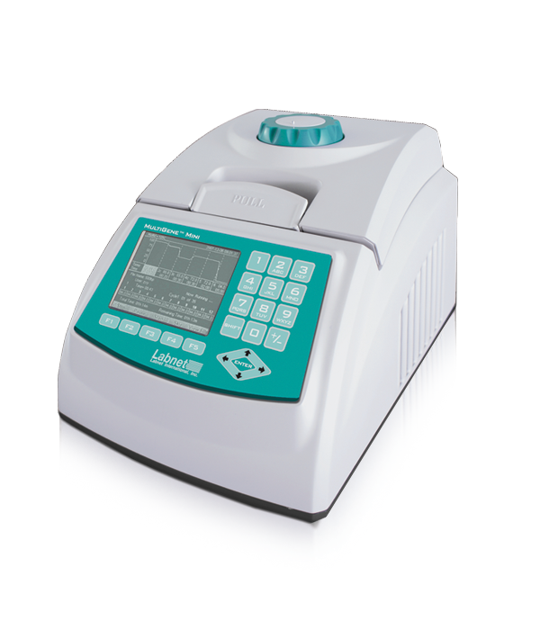
Molecular techniques: (mainly PCR)
Principle of the PCR
The purpose of a PCR (Polymerase Chain Reaction) is to make a huge number of copies of a gene.

Slide 24
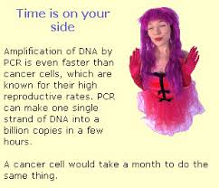

Slide 25


