Slide 1
ECHINOCOCCUS GRANULOSUS
HYPER TAPE WARM – HYDATID WORM –DOG TAPE WORM

Slide 2
HISTORY
E. granulosus was first documented in Alaska

Slide 3
DISTRIBUTION
distributed world-wide

Slide 4
TRANSMISSION
Hydatid disease is a zoonotic .
Transmission by ingesting E.granulosus eggs in food contaminated with dog feces or from hands that have become contaminated when handling infected dogs .

Slide 5
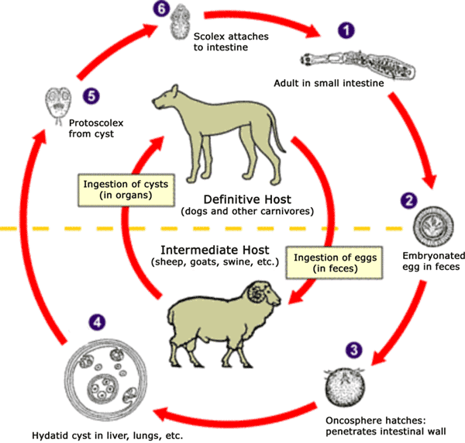
Life cycle – indirect life cycle

Slide 6
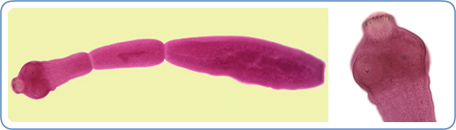
Worm & scolex

Slide 7
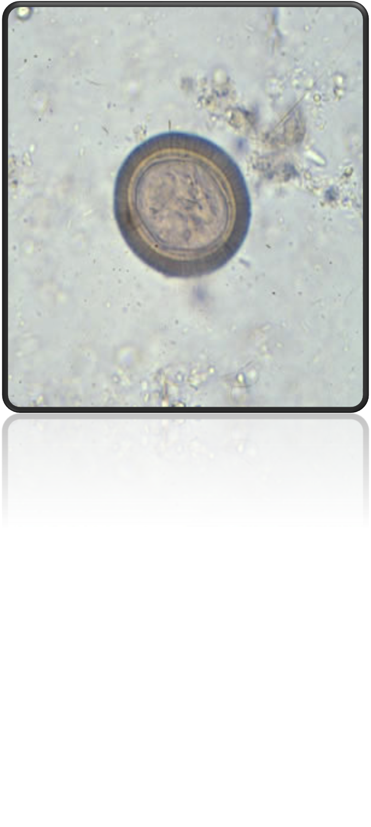
Egg

Slide 8
Clinical presentation
Cystic echinococcosis / hydatid disease
Human infection with E. granulosus leads to the development of one or more hydatids located mainly in the liver and lungs, and less frequently in the bones, kidneys, spleen, muscles, central nervous system and eyes

Slide 9
Continued
The asymptomatic incubation period of the disease can last many years until hydatid cysts grow to an extent that triggers clinical signs. Non-specific signs include anorexia, weight loss and weakness. Other signs depend on the location of the hydatid and the pressure exerted on the surrounding tissues.

Slide 10
Continued
Abdominal pain, nausea and vomiting are commonly seen when hydatids occur in the liver. If the lung is affected, clinical signs include chronic cough, chest pain and shortness of breath.

Slide 11
Diagnosis
Mainly serological (e.g. Casoni test ) .
Molecular techniques (PCR) .
Ultrasonography
Computed tomography scan (CT).
Magnetic resonance imaging scan (MRI) .

Slide 12
TREATMENT
Mostly by surgical intervention .

Slide 13
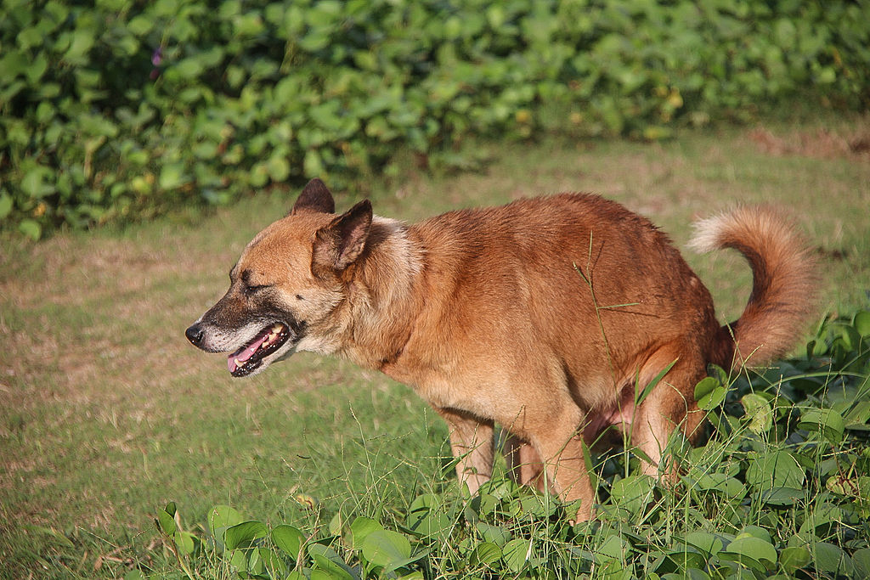
The definitive host –dogs

