Slide 1
Malaria

Slide 2
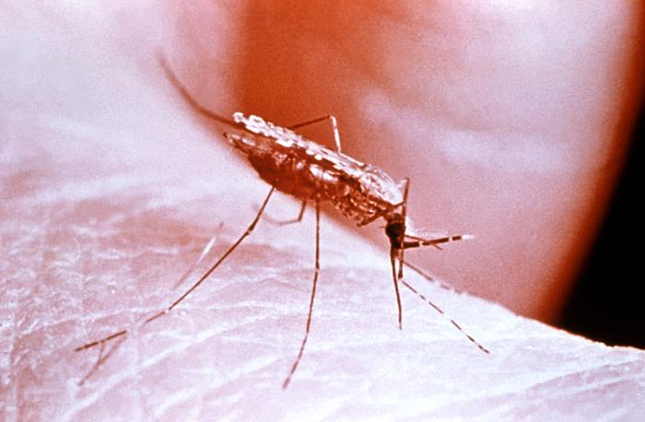
Definition
Malaria is a vector borne disease .

Slide 3
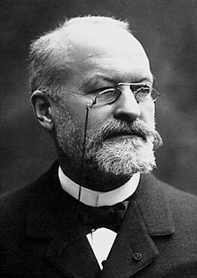
History
Malaria derived from Italia word mal –aria
( which means bad air )
Also it was known as swamp fever .
Discovered by French physician laveran 1880
in Algeria .

Slide 4
Distribution
Mainly in tropical countries ( due to the presence of vectors).

Slide 5
transmission
Malaria transmit to man by 3 ways :
Bites of infected female of Anopheles mosquito .
Transplacental from infected mothers .
Blood transfusion ( trophozoite induced malaria)

Slide 6
Life cycle
Indirect life cycle
Intermediate host : man
Definitive host : Female of Anopheles mosquitoes

Slide 7
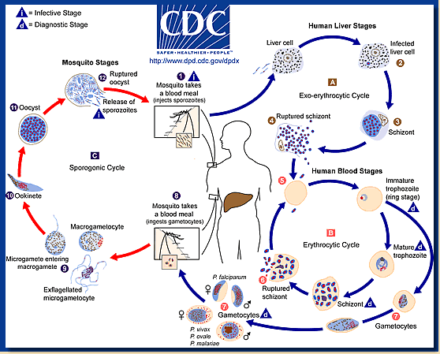
Life cycle – diagram

Slide 8
Infective stage : sporozoite ( injected by F.A.mosquitoes )
Diagnostic stages : trophozoite, schizont , gametocyte
Habitat :
Firstly : go to liver ( hepatic schizogony)
lastly : entering RBCs ( Erythrocytic schizogony )

Slide 9
Signs and symptoms
Cardinal signs of malaria :
Fever
Cold stage
Sweating .
Others :
Nausea
Vomiting
Fatigue

Slide 10
Complications
Anemia
Jaundice
hypoglycemia
Coma
Death

Slide 11
Diagnosis
Specimen :
Blood ( capillary / venous )
Methods of diagnosis :
Parasitological methods :
Examination of blood smears :
Thin smear
Thick smear

Slide 12
Other diagnostic methods
Immunochromatographic tests
Culture methods (RPMI)
Polymerase chain reaction ( PCR)

Slide 13
Control
Health education
Treating of infected persons
Using of biological ,chemical and physical method to prevent vector breeding .

Slide 14
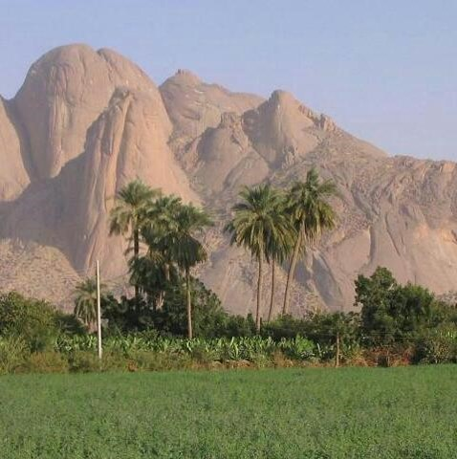
Thank you

