Slide 1

Parasitology gallery
Nobel session

Slide 2
The dream of all scientists

Slide 3
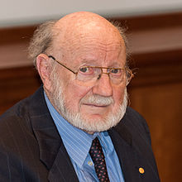
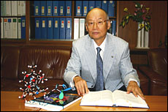
William C.Campell & Satochi Omura

Slide 4
the Nobel prize in physiology & medicine 2015
William C.Campell & Satochi Omura
for their discoveries concerning a novel therapy against infections caused by roundworm parasites

Slide 5
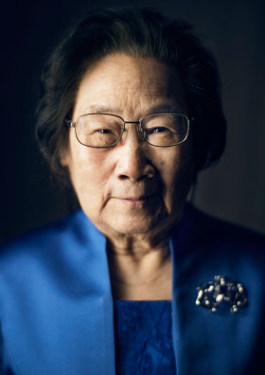
Youyoy TU

Slide 6
the Nobel prize in physiology & medicine 2015
Youyoy Tu
For her discoveries concerning a novel therapy against malaria

Slide 7
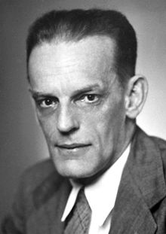
Max Theiler

Slide 8
the Nobel prize in physiology & medicine 1951
Max Theiler
For his discoveries vector borne disease ( yellow fever) and how to combat it

Slide 9
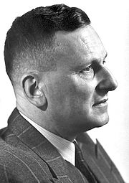
Paul Hermann Muller

Slide 10
the Nobel prize in physiology & medicine 1948
Paul Hermann Muller
For his discovery of the high efficiency of DDT as a contact poison against several arthropods

Slide 11
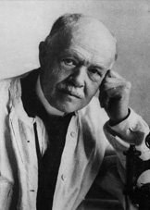
Charles Jules Henri Nicole

Slide 12
the Nobel prize in physiology & medicine 1928
Charles Jules Henri Nicole
For his work on vector borne disease ( Typhus)

Slide 13
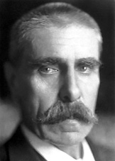
Julius Wagner Jauregg

Slide 14
the Nobel prize in physiology & medicine 1927
Julius Wagner Jauregg
For his discoveries of the therapeutic value of malaria inoculation in the treatment of dementia paralytica

Slide 15
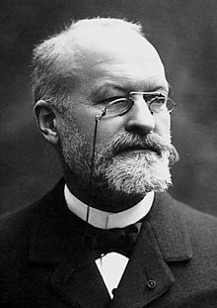
Charles Louis Alphonse Laveran

Slide 16
the Nobel prize in physiology & medicine 1907
Charles Louis Alphonse Laveran
In recognition of his work on the role played by plasmodium in causing malaria

Slide 17
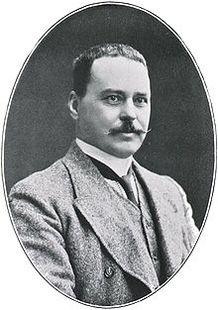
Sir. Ronald ross

Slide 18
the Nobel prize in physiology & medicine 1902
Ronald Ross
For his work on malaria , by which he has shown it enters the organism and thereby has laid the foundation for successful research on malaria and methods of combating it .

Slide 19
NEXT
p
YEARs
a
MAY
r
YOU
s
Be
a
me
i
You
e
Yes
t

