Slide 1
Teaching techniques
Mosab Nouraldein

Slide 2
Dear educator
“Inform the facts , explain the phenomenon and press always on the key of motivation then you will provide community with real leaders”

Slide 3


Slide 4
Purposes of teaching
Understanding of information
Practicing of information
Recalling of information
Acquiring of skills
Enhance the power of explanation

Slide 5
Sources of lectures
Its better to teach your students from recently published research articles about the topic you are desire to teach them.
Stores , that faced you during professional life ,strange cases, complicated cases even normal cases.
Ordinary and traditional methods such as text books must be used as extra-sources not key sources of teaching materials.

Slide 6
Lecturer must link between the local environment of his/her student and the topic of lecture.
Be SFR, (SERIOUS,FUNNY, READY).
Serious most , funny often and ready at all.

Slide 7
End your lecture with the brief summary about the topic of your lecture.
Finish the lecture with small quiz.

Slide 8
Divide your student into small seminar groups
and provide them certain phenomenon to discuss about it and to explain it and if it can be practiced allow to them to do it their laboratory.

Slide 9
You should remember that you are marketer and the students is you customers and information is your good so you must present it with the best way.

Slide 10
Simple prize have a big meaning to your students , so encourage them with some prizes even pen or a book .
Continuous motivation , is important tell the end of the course.

Slide 11
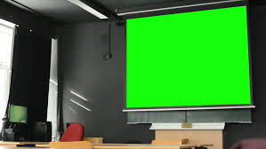
Thank you

