Slide 1
Medical Parasitology Department quiz on :
Nematodes

Slide 2
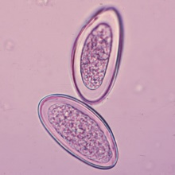
1-Identify?

Slide 3

2-Identify ?

Slide 4
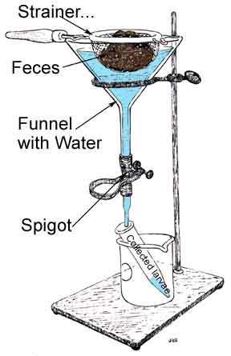
3-Identify ? Mention the use of this apparatus?

Slide 5
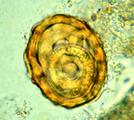
4-Identify ?

Slide 6
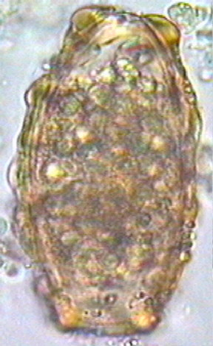
5-Identify ?

Slide 7
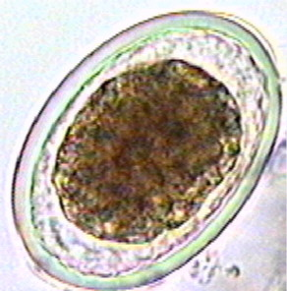
6-Identify ?

Slide 8
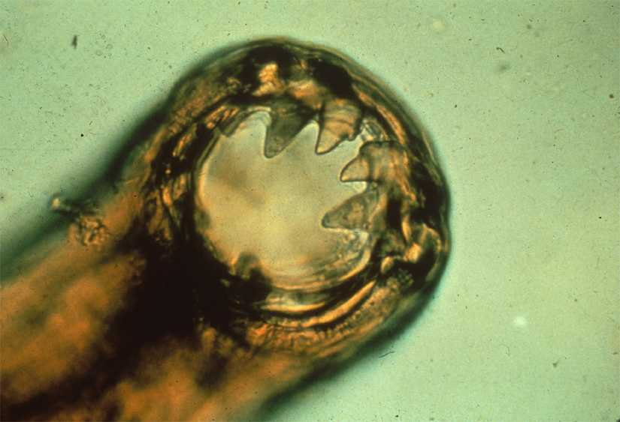
7-Identify ?

Slide 9
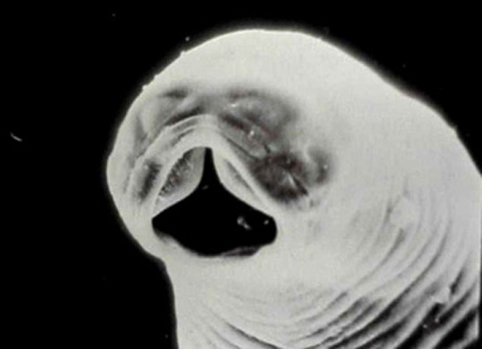
8-Identify ?

Slide 10
9-Identify ?

Slide 11
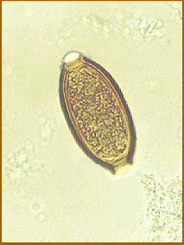
10-Identify ?

Slide 12
11-Mention the causative agent of the followings:
Rectal prolapse ?
Iron deficiency anemia ?
Intestinal obstruction ?
Perianal itching ?
Ground itch ?

Slide 13
12-Describe & draw the followings :
Enterobius vermicularis egg ?
Trichiuris trichiura egg ?
Unfertilized egg of Ascaris lumbricodes ?

Slide 14
13-Case
12 years old child suffer from severe lower abdominal pain and dysentery, which is the possible nematode that may cause this condition ?

Slide 15
14-Discuss Stoll technique?

Slide 16
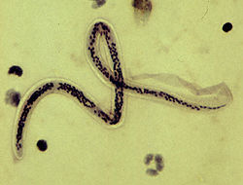
15-Identify ?

Slide 17
Thank you

