Slide 1
Parasitology department
Revision
Nematodes

Slide 2
Nematodes
Other names:
Thread worm (unsegmented)
Round worm

Slide 3
Methods of classifications:
Zoological
According to mode of transmission
According to residing( habitats)
According to outcome of reproduction (larva or ovum)

Slide 4
Malabsorption
Is the a clinical feature of nematodes inhabit the small intestine :
Ascaris lumbricoides
Hook worms
Strongyloides stercoralis

Slide 5
Intestinal obstruction
It’s a clinical feature of heavy infection with Ascaris lumbricoides.

Slide 6
A. Lumbricoides Possess 3 types of eggs(ova):
Fertilized egg( round with thin albuminous coat ).
Unfertilized egg( elongate(oval) with thick albuminous coat and contains coarse granules).
Decorticated egg( without albuminous coat)

Slide 7
Iron deficiency anemia
Usually associate with moderate and heavy hook worm infection .

Slide 8
Black colored stool
Occur due to presence of occult blood in case of hook worm infection.

Slide 9
Nematodes of large intestine
E .vermicularis
T. trichiura

Slide 10
Insomnia
Not able to sleep due to severe preianal itching.
Associate with E.vermicularis infection.

Slide 11
Parathogen
Strongylodies stercoralis adult female able to fertilize itself without need to male partener.

Slide 12
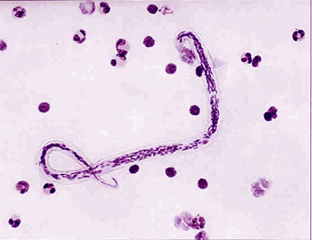
Identify

Slide 13
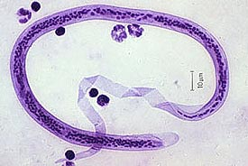
Identify

Slide 14
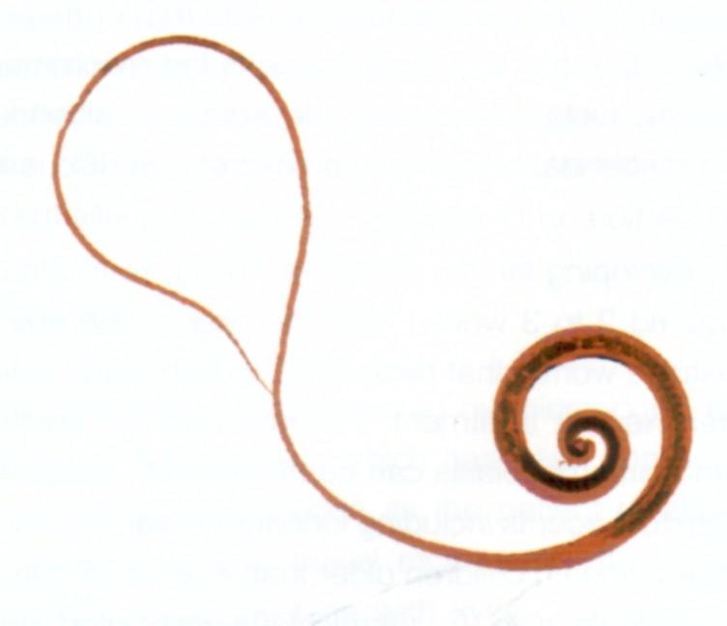
Identify ?

Slide 15
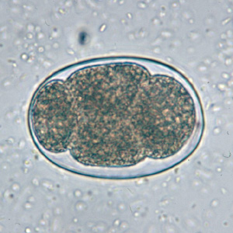
Identify

Slide 16
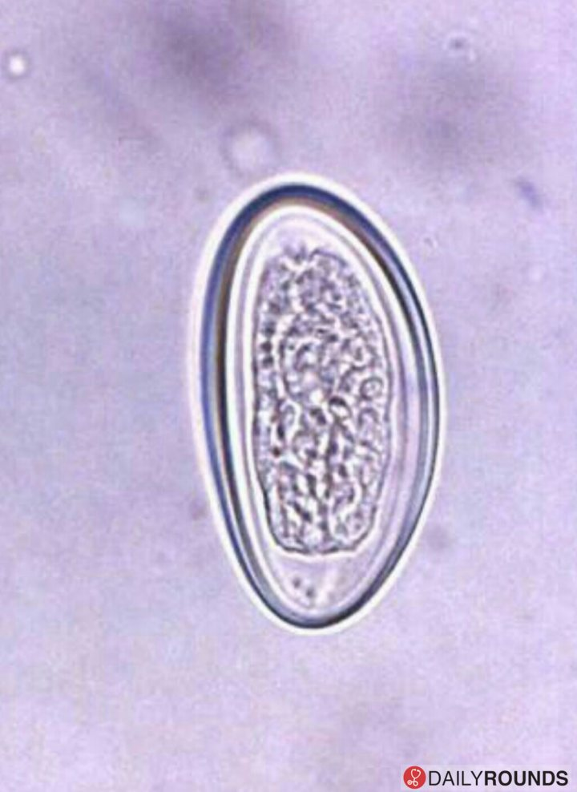
Identify

Slide 17
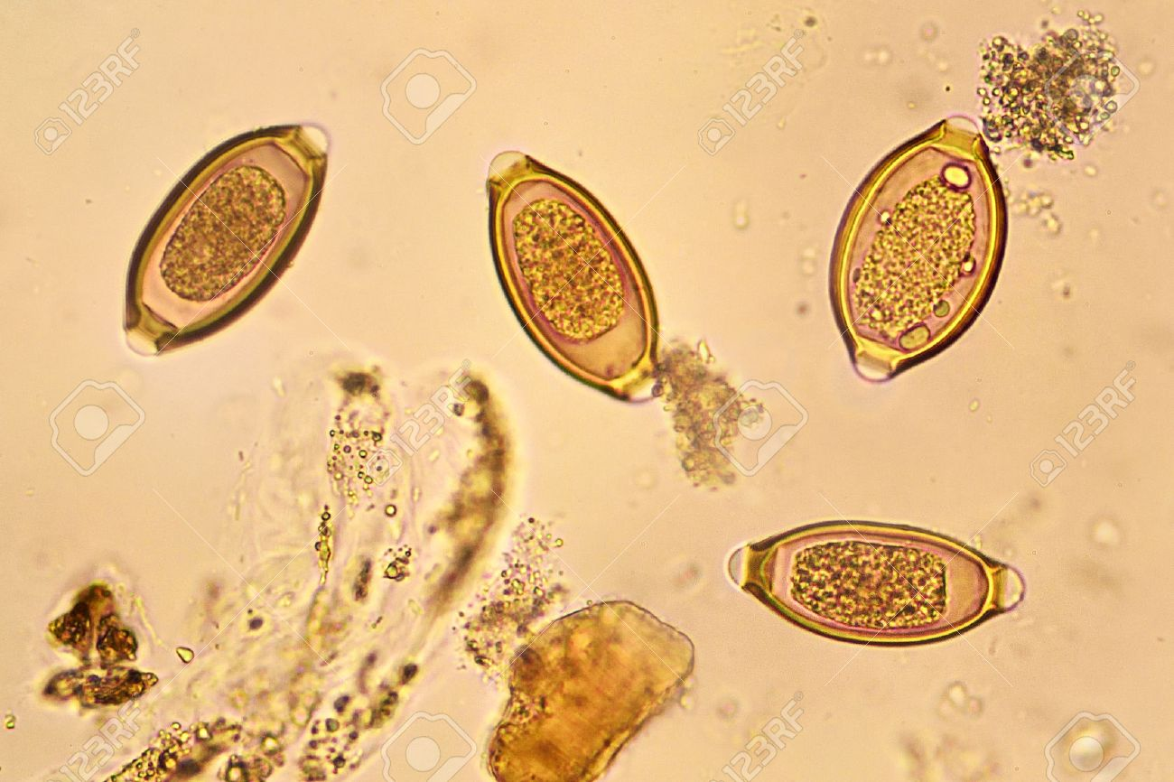
Identify

Slide 18
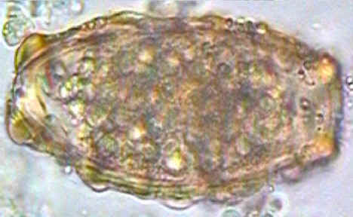
Identify

Slide 19
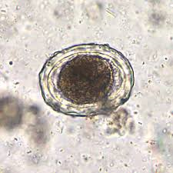

Slide 20
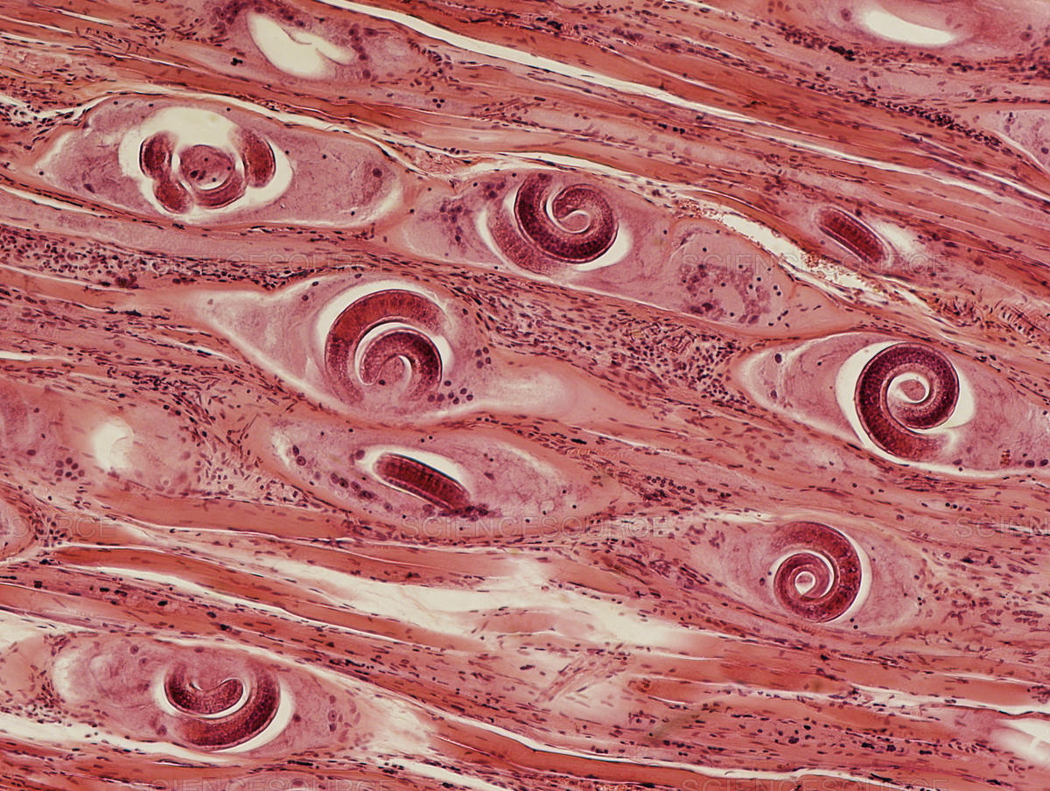
Identify

Slide 21
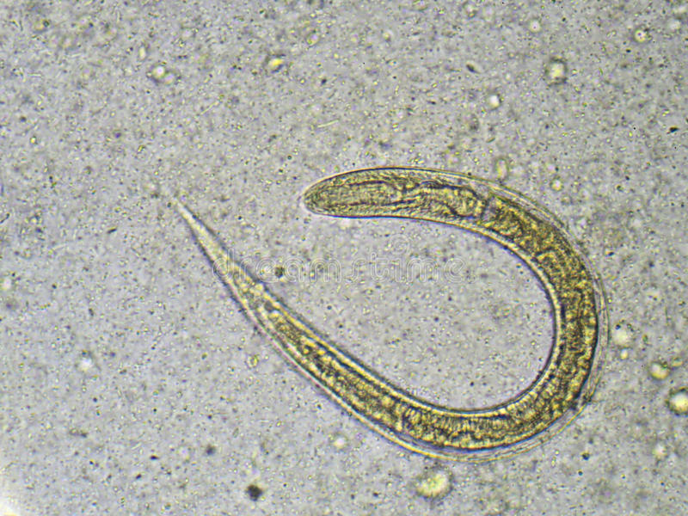
Identify

Slide 22
Table
Scientific name | Common name/s
Enterobius vermicularis | Pin worm
Trichiuris Trichiura | Whip worm
Strongyloides Stercoralis | Dwarf thread worm
Nematodes | Round worm / Thread worm
Loa loa | Eye worm

Slide 23
Filarial worms
Either inhabit :
Lymphatic tissues /or/
Subcutaneous tissues

Slide 24
Lymphatic filarial worms
W. bancrofti
Brugia species.

Slide 25
Subcutaneous filariasis
Caused by:
Loa loa
Onchocerca volvulus
Dracunclus medinensis (Guiena worm)

Slide 26
How to differentiate between lymphatic microfilaria?
No nuclei at the tip of the tail in W.bancrofti.
Two nuclei in the tail of Brugia species (terminal and sub terminal).

Slide 27
Loa loa
Nuclei extended to the tip of the tail.
Diurnal periodicity
Specimen : blood
Vector : deer fly

Slide 28
Onchocerca volvulus
(subcutaneous filariasis)
Un sheathed
Non periodic
Nuclei extended to the tip of tail
Specimen: skin snip.
Cause : river blindness
Vector: black fly

Slide 29
Techniques
Technique | Parasite
Wet preparation | All intestinal nematodes
NIH swab | E.vermicularis
Scotch tape technique(adhesive tape method) | E.vermicularis
Stoll technique | To count egg s of hook worm
Baermanns apparatus | Hook worm/ strongyloides stercoralis
Skin snip | Onchocerca volvulus

Slide 30

Thank you

