Slide 1
Plasmodium falciparum
Mosab Nouraldein

Slide 2
Disease
Malaria caused by Plasmodium falciparum is referred to as falciparum malaria , formerly known as subtertian (ST) or malignant malaria ( MT) .
It is the most serious form of the disease and the most wide spread , accounting for up to 80% of malaria cases worldwide .

Slide 3
Distribution
Found mainly in the hotter and more humid regions of the world .

Slide 4
Modes of transmission
By the bites of infected female of Anopheles mosquito
Transfusion of infected donor blood
Injection through the use of needles and syringes contaminated with infected blood
Congenital transmission occurs , usually when a mother is non- immune .

Slide 5
Types of transmission
Stable malaria :
In areas where malaria transmission is stable , transmission occurs for at least 6 months .
Unstable malaria :
In areas where malaria transmission is unstable there are marked changes in transmission from one season to another and from one year to another

Slide 6
Life cycle
Sporozoite contained in the saliva of an infected Anopheles mosquito are injected into the blood of a human host when it takes a blood meal .
The sporozoites are elongate bodies measuring about 11um in length , with a central nucleus .

Slide 7
After circulating in the blood stream for not more than one hour , the sporozoites enter liver cells ( hepatocytes) .
In liver cells , Plasmodium falciparum grow , multiply and develop directly into schizonts .
The schizonts in the liver are referred to as pre-erythrocytic schizonts or exo-erythrocytic schizonts

Slide 8
Pre-erythrocytic schizont of P.falciparum take 5-7days to develop .When mature each schizont measures about 60um in diameter and contain up to 30000 merozoites .
When mature , the schizont and liver cell rupture and merozoites enter the bloodstream .To survive , the merozoites must enter red blood cells ( erythrocytes) within few minutes of being released from PE schizont .

Slide 9
Most of the merozoites enter red cells in the sinusoids of the liver . A proportion are phagocytosed and destroyed .
Entry of the parasites into red cells starts a cycle in the blood ( erythrocytic cycle) which takes 36-48 hours to complete .

Slide 10
The merozoite develop into a trophozoite within a vacuole formed by the internal membrane of the host red cell .
The trophozoite feeds on hemoglobin by ingesting small amounts of red cell cytoplasm .
Malaria pigment ( hemozoin) forms as an end-product of hemoglobin breakdown . It accumulates as brown-black granules in the trophozoites .

Slide 11
As the trophozoite grows it becomes globular in form and the vacuole membrane enlarges .
Maurer’s dots (clefts) form which can be seen in stained preparation as irregular sized mauve-red staining dots.

Slide 12
Red cells containing late stage trophozoites and schizonts develop small knobs on their surface ( visible by electron microscopy) .
When the trophozoite is fully developed , its nucleus begins to divide , followed by a division of cytoplasm .This process is known as schizogony which results in the formation of schizont .

Slide 13
A mature schizont contain 8-32 merozoites and malaria pigment .P.falciparum erythrocytic schizogony takes place in the capillaries of the internal organs in the body .
Mature schizont rupture from the red cells , releasing merozoites , malaria pigment and toxins into the plasma .The entry of toxic metabolites into the blood circulation of the host causes fever and a malarial attack .
The incubation period for P.falciparum ( period from infection to an attack) is 9-14 days.

Slide 14
Those merozoites which are not destroyed by the host’s immune system , invade new RBCs . They develop into trophozoites and schizonts and so cause further red cells to be destroyed .
In falciparum malaria , large numbers of RBCs can become infected and many cells many contain more than one trophozoite .

Slide 15
After several erythrocytic cycles , some of the merozoites enter RBCs and instead of developing into schizonts they follow a sexual development and become gametocytes .
Gametocytes are thought to form in response to developing immunity , lack of nutrients and accumulation of metabolites or parasitic debris . Their presence in blood is not proof of active infection .

Slide 16
The gametocyte need to be by a female Anopheles mosquito in a blood meal , if they are not taken up by a mosquito vector , they die.
In the stomach of the female of Anopheles mosquito , the male gametocyte rapidly divides into a number of male gametes each with flagellum ( exflagellation) . These become free and highly motile . Following contact and entry into a female gamete , fertilization occurs. The male nucleus fuses with the female nucleus and a zygote is formed .

Slide 17
The zygote develops into a motile ookinete which penetrate the stomach wall of the Anopheles mosquito forming an oocyst . Inside the oocyst , large numbers of sporozoites are formed , when mature the sporozoites leave the oocyst and spread to all parts of the mosquito , particularly to the salivary glands , ready to be transmitted when the female of Anopheles mosquito next takes blood meal .

Slide 18
Development of the plasmodium falciparum in the Anopheles mosquito ( sporogongy ) takes 9-10 days at 28 C.

Slide 19
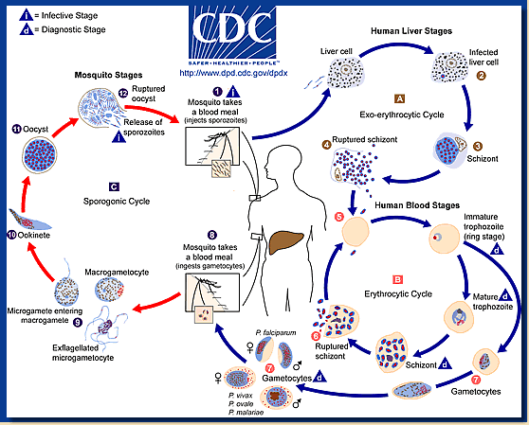
Life cycle

Slide 20
Clinical features
Febrile attack ( cold stage, fever stage, sweating stages) .
Severe falciparum malaria
Severe falciparum malaria is more likely to occur in non immune person ( no previous exposure ) , person with lapsed immunity , pregnant woman , immunosuppressed person , or following splenectomy .

Slide 21
A falciparum malaria should be considered severe when more than 5% of the RBCs become parasitized .

Slide 22
complication of severe falciparum malaria:
Cerebral malaria
Anemia
Black water fever
Diarrhea & vomiting
Pulmonary oedema

Slide 23
Hypoglycemia

Slide 24
Biological resistance
Some individuals living in malaria endemic areas of the world have a natural resistance to malaria based on the inheritance of selected resistance genes expressed in RBCs.

Slide 25
Genes which select against falciparum malaria include :
Hemoglobin S gene
Thalassemia genes
Glucose -6- phosphate dehydrogenase deficiency genes
Ovalocytosis gene

Slide 26
Recrudescence
It is the occurrence of clinical falciparum malaria caused by parasites persisting in the circulation at a subclinical level following a previous attack .

Slide 27
Lab diagnosis
Examination of stained thick blood film , to detect the parasites and to examine white cells for malaria pigment
Examination of stained thin blood film to identify the species and to give estimate of the percentage of RBCs infected .
Examination of buffy coat and RBCs immediately below it after centrifugation of blood in a small narrow bore tube.

Slide 28
Immunochromatographic test
ELISA
PCR
Culture

Slide 29
Many parasites may be present
Usually only trophozoite and gametocyte are seen

Slide 30
Host RBCs :
Not enlarged
Cells containing late stage trophozoites often show irregular maurer’s dots .
May contain several parasites
Parasite may lay on RBCs membrane ( accole form) .

Slide 31
Trophozoite ( ring form) :
Mainly small and delicate with thin ring or part of ring of blue cytoplasm and dark red staining chromatin dot .
May have double chromatin dot
in heavy infection few larger and more compact trophozoites may be seen with many small trophozoites .

Slide 32
Schizont ( dividing form)
Very rarely seen .
Their presence in peripheral blood indicate heavy infection
Small, immature containing two or four merozoites and clumps of dark colored pigment .

Slide 33
Gametocyte ( sexual form)
Typically crescent ( banana , sausage ) shaped with rounded or pointed ends but oval forms may also be seen .
Compared with the male gametocyte , the female gametocyte stains more deeply and bluer and has more compact nucleus with less scattered pigment granules .

Slide 34
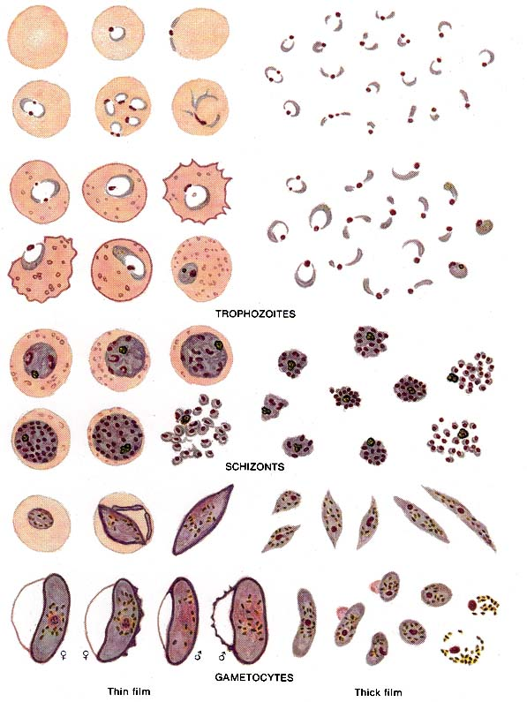
P.falciparum, stages

Slide 35
