Slide 1
Elrazi university faculty of medical laboratories science
Practical exam
Spot
Sup substitute exam

Slide 2
You have 3 minutes for each question
Please answer all questions

Slide 3
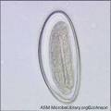
1
1- identify ?
2-mention the possible routes of transmission ?

Slide 4
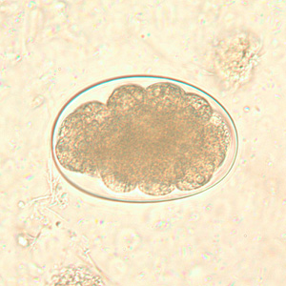
2
1-identify ?
2-the possible colors of stool containing this parasite ?

Slide 5

3
1-identify ?
2- what is the possible
Intermediate host to this
Parasite?

Slide 6
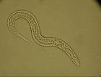
4
1-identify ?

Slide 7
5
Mention the tests used to check the viability of schistosomes?
1-
2-

Slide 8
6
Mention the main ways used to preserve stool specimen ?
1-
2-

Slide 9
7
Mention 2 types of anticoagulants used in parasitology lab?
1-
2-

Slide 10
8
When we should collect urine specimen for schistosomiasis ?

Slide 11
9
Mention 2 differences between filaria & mansonella species ?
1-
2-

Slide 12
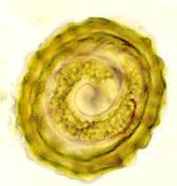
10
1- identify ?
2- mention (3) eggs forms of this parasite ?

Slide 13
11
Mention 2 uses of concentration techniques in parasitology lab?
1-
2-

Slide 14
12
Draw the egg of :
1- Schistosoma mansoni
2- Schistosoma haematobium

Slide 15
13
Mention 2 helminthic infections causing anaemia ?

Slide 16
14
Rusty sputum is a characteristic specimen is characteristic for infection with certain parasite , mention it ?

Slide 17
15
Casoni test is a serological test used to diagnose ?

Slide 18
16
Mention 3 helminthic parasites that can be detected in urine sample ?
1------------------------------------------------
2-------------------------------------------------
3--------------------------------------------------

Slide 19
17
How we can differentiate between eggs of Taenia species ?

Slide 20
18
Which parasite that can be diagnosed by NIH swab?

Slide 21
19
Mention the following :
1- parasite diagnosed by Stoll technique ?
2- the aim of Stoll technique ?

Slide 22
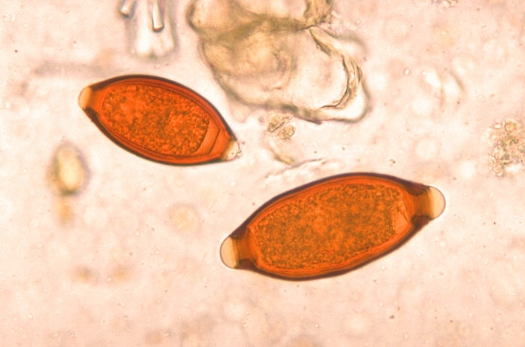
20
Identify

