Slide 1
Enterobius vermicularis
Oxyuris vermicularis , pin worm, thread worm, seat worm , family worm
Mosab Nouraldein Mohammed

Slide 2
Enterobius vermicularis = (derived from Greek , enteron = intestine ,
Bios = life , vermicularis = small worm)
Oxyuris = sharp tail

Slide 3
It is described first by Linnaeus , in 1758 .
It is the causative agent of Enterobiasis .
It has world wide distribution .

Slide 4
Globally , around 209 million people are infected by pin worms .
The prevalence is maximum in school children between the age of 5 and 10 years .
Prevalence rate has been reported as high as :
61% in India 39% in Thailand 29% in Denmark
50% in Britain 37% in Sweden 11% in United States
Sudan….??????

Slide 5
Modes of transmission
Ingestion of Embryonated egg
Inhalation of Embryonated egg
Autoinfection
Retroinfection

Slide 6
Life cycle
Direct life cycle ( humans are the only host)
Embryonated egg is the infective stage .
Ingestion of Embryonated egg
Egg hatch in duodenum
Migrate to colon , molt twice and become adult worm

Slide 7
Females survive for 5 to 13 weeks , male survive 7 weeks.
Male and female mate in the ileum , after that male usually die .

Slide 8
The fertilized( gravid) females settle in the large intestine .
The egg laying process begins about five weeks after initial ingestion of pin worm eggs .
The number of eggs in gravid female range from 11000to 16000 egg .

Slide 9
The gravid female migrate to the rectum, they emerge from the anus ,and deposit eggs .
The females emerge from the anus to obtain oxygen which is necessary for the maturation of eggs .
After depositing egg the female becomes opaque and then die .

Slide 10
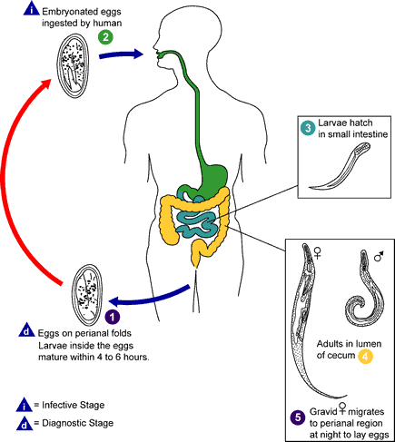

Slide 11
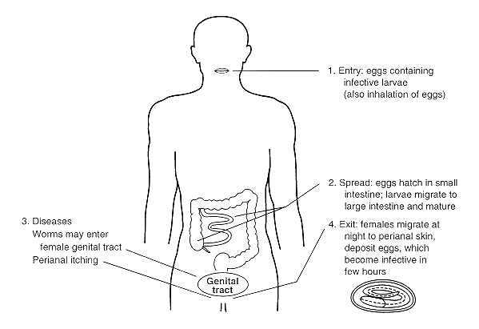

Slide 12
Clinical features
Mostly are asymptomatic
Symptoms may depend on:
Patient‘s age
Patient’s sex
Females , children and young adults are often symptomatic than male and older people .

Slide 13
Cardinal symptoms :
Perianal pruritus , often worse at night as a result of the nocturnal migration of the female worm .
Excoriation of the perianal skin and bacterial super-infection may occur ( due to continuous scratching of the skin)
Abdominal pain
Weight loss ( seen in heavy infection)

Slide 14
Migration of the worm :
rarely pinworms invade the female genital tract , causing vulvovaginitis .
Other sites involved are urinary tract , peritoneal cavity (peritoneal granulomas), lung and liver .

Slide 15
Laboratory diagnosis
Specimens:
Perianal swab , stool , urine( female)
Diagnostic stages:
Egg , Adult stage .
Diagnostic methods :
NIH swab ( National Institute of Health)
Scotch tape technique
Stool wet mount

Slide 16
Examination of urine deposit
Eggs may be detected beneath the finger nails .
Saturated sodium chloride floatation techniques

Slide 17
Morphology:
Adult stage:
Small , white , and thread like ( hence called thread worm).
The adult worm bears a wing like expansion of the cuticle near the anterior end , named Cervical alae.
It has double bulb esophagus

Slide 18
Male is smaller , and the posterior one-third is tightly curved and bears a copulatory bursa with spicules at the posterior end.
Male die soon after fertilization .

Slide 19
Female worm is longer , and the posterior one-third is straight ,thin and pointed ( look like a pin ,hence called as pin worm) .

Slide 20
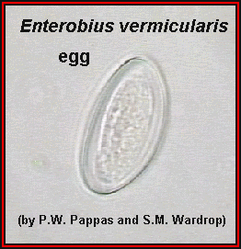
Egg :
planoconvex
Surrounded by double layered egg shell
Colorless
Embryonated when passed fresh
Float in saturated salt solution

Slide 21
Prevention and control
Health education
Community chemotherapy ( mebendazole)
Improvement of personal hygiene .

Slide 22
Quiz
Classify this parasite?
Mention the routes of transmission?
Describe the egg of Enterobius vermicularis?
Define :
Autoinfection?
Retroinfection ?
discuss – lab diagnosis of pin worm infection?

